Slide 1
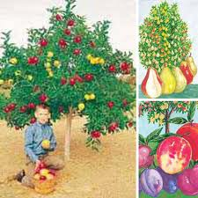
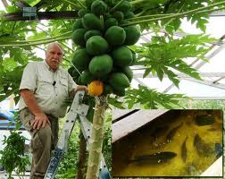
WELCOME TO:
THE FRUIT OF THE SPIRIT’s seminar
Don’t tell me that you love me, but show me instead.
ENGLISH AND FRENCH

Slide 2
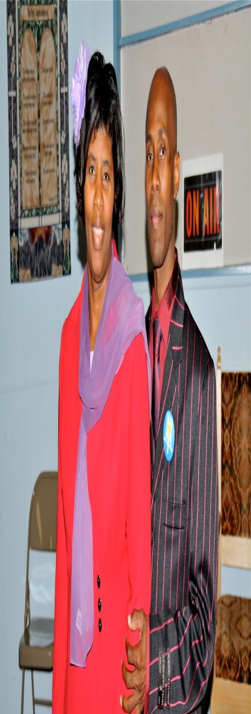
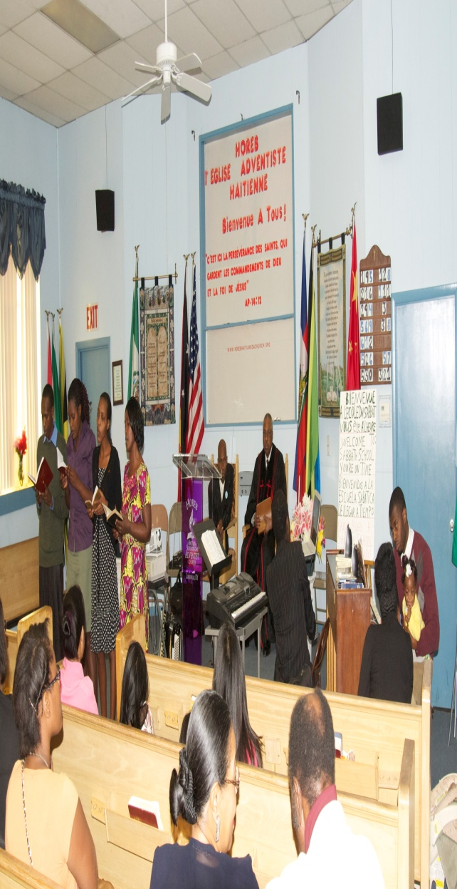
PASTOR: CELEVE IZEAN
FROM:
“HOREB” HAITIAN ALL NATION S.D.A CHURCH
LOUISVILLE, KENTUCKY
PASTOR CELEVE AND WIFE CELICIA

Slide 3
THE FRUITS OF THE SPIRIT IS:
Galatians 5:22,23
²² But the fruit of the Spirit is love, joy, peace, longsuffering, gentleness, goodness, faith, ²³ Meekness, temperance: against such there is no law.
FRENCH
Galates 5:22,23
²² Mais le fruit de l'Esprit, c'est l'amour, la joie, la paix, la patience, la bonté, la bénignité, la fidélité, la douceur, la tempérance; ²³ la loi n'est pas contre ces choses.

Slide 4
THE DIFERENCE BETWEEN :
VEGETABLES AND FRUITS
Vegetable normally refers to the leafy green, stem, root or even flower stalk portion of an edible plant. It is a generic term and used interchangeably!
Fruit on the other hand are specific, they are the swollen (normally, but not always ripe) ovary of a plant and (contain seeds.)
A fruit is a ripened ovary, enclosing the seeds which are the mature ovules. They can arise from a single carpel, or several carpels fused together, or separate carpels.

Slide 5
DIFFERENT FRUITS
Some fruit which we eat such as bananas do in fact have seeds in them, although the seeds never mature and banana plants very rarely grow from a banana. Other fruit though, such as apples, pears, avocado etc. do produce viable seed which can produce a new plant if collected, planted and germinated.
Examples of vegetables include:
carrot, potato, lettuce, cabbage, cellery, brocolli, cauliflower
Examples of fruit include:
peach, pear, cherry, orange, apple, banana, mellon, eggplant, tomato and cucumber. A difficult one is the pea, eaten whole in the pod it's technically a fruit, but remove the peas the pod? then what is a pea a fruit or a vegetable?

Slide 6
WHAT IS THE DEFINITION OF LOVE ACCORDING TO THE DICTIONARY?
LOVE IS A VERB.
transitive and intransitive verb to feel tender affection for somebody such as a close relative or friend, or for something such as a place, an ideal, or an animal.
A passionate feeling of romantic desire and sexual attraction.
Christianity in Christian belief, the mercy, grace, and charity shown by God to humanity.

Slide 7
Ancient Hebrew Word Meanings
Love ~ ahav
We do not choose our parents or siblings but are instead given to us as a gift from above, a privileged gift. Even in the ancient Hebrew culture ones wife was chosen for you. It is our responsibility to provide and protect that privileged gift. In our modern Western culture love is an abstract thought of emotion, how one feels toward another but the Hebrew meaning goes much deeper. As a verb this word means "to provide and protect what is given as a privilege" as well as " to have an intimacy of action and emotion". We are told to love God and our neighbors, not in an emotional sense, but in the sense of our actions.
By Jeff A. Benner

Slide 8
Ancient Greek
Greek distinguishes several different senses in which the word "love" is used. For example, Ancient Greek has the words philia, eros, agape, storge, and xenia. However, with Greek (as with many other languages), it has been historically difficult to separate the meanings of these words totally. At the same time, the Ancient Greek text of the Bible has examples of the verb agapo having the same meaning as phileo.
Agape (ἀγάπη agápē) means love in modern-day Greek. The term s'agapo means I love you in Greek. The word agapo is the verb I love. It generally refers to a "pure," ideal type of love, rather than the physical attraction suggested by eros. However, there are some examples of agape used to mean the same as eros. It has also been translated as "love of the soul."

Slide 9
Ancient Roman (Latin)
The Latin language has several different verbs corresponding to the English word "love." amō is the basic verb meaning I love, with the infinitive amare (“to love”) as it still is in Italian today.

Slide 10
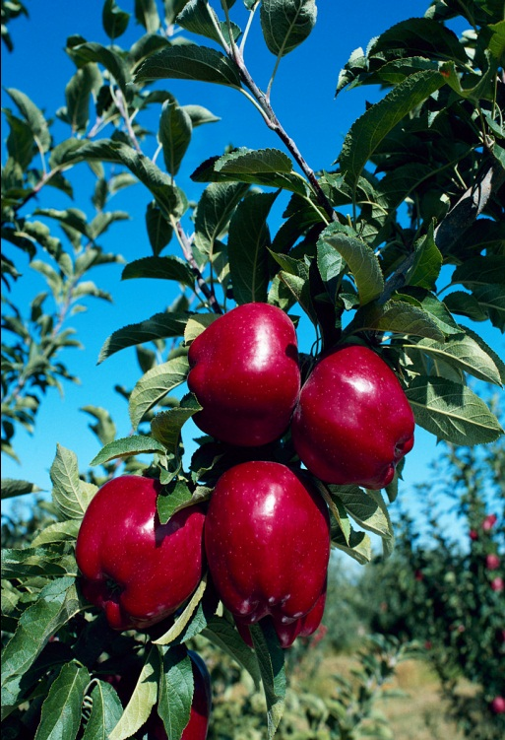
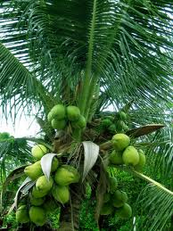
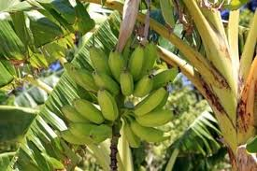
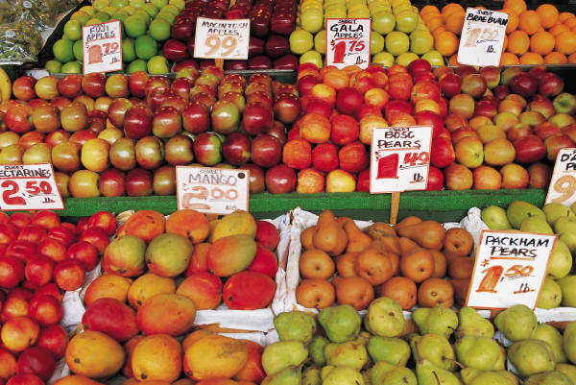
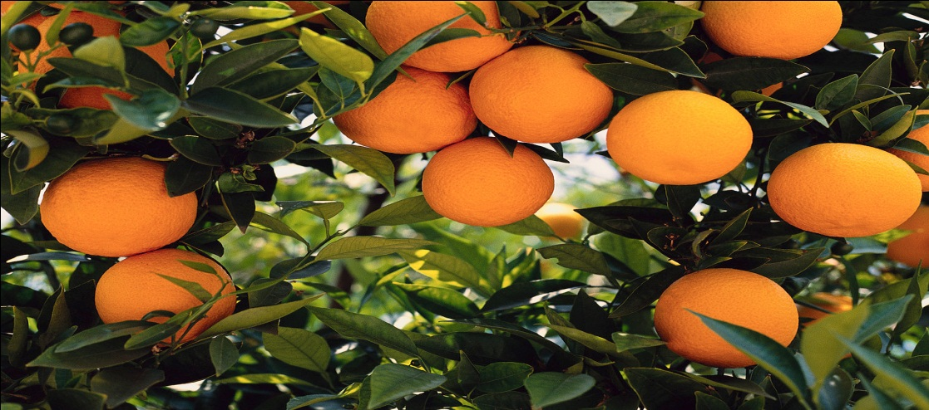
THE FRUITS OF THE SPIRIT
HERE IS SOME FRUIT TREES! (FRUIT GROW TALL)

Slide 11
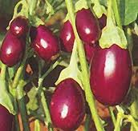
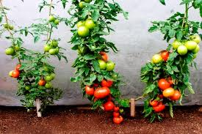
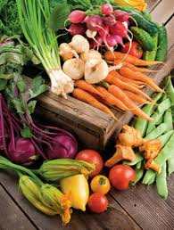
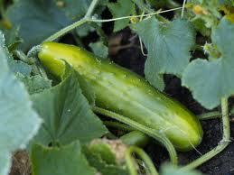

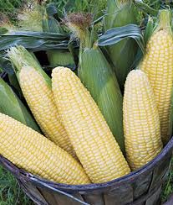
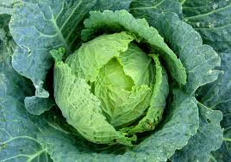
THE FRUITS OF THE SPIRIT
HERE IS SOME VEGETABLES! (VEGETABLES STAY LOW)

Slide 12
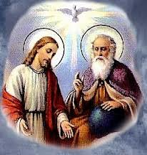
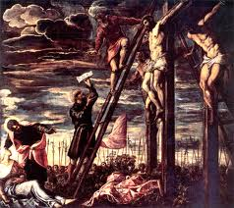
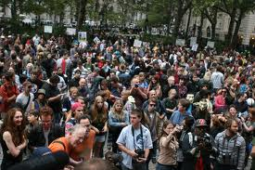
THE FRUIT OF THE SPIRIT IS:
(LOVE)
John 3:16
¹⁶ For God so loved the world, that he gave his only begotten Son, that whosoever believeth in him should not perish, but have everlasting life
FRENCH
Car Dieu a tant aimé le monde qu'il a donné son Fils unique, afin que quiconque croit en lui ne périsse point, mais qu'il ait la vie éternelle.

Slide 13
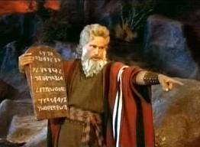
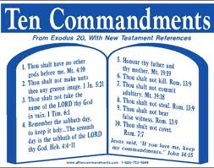
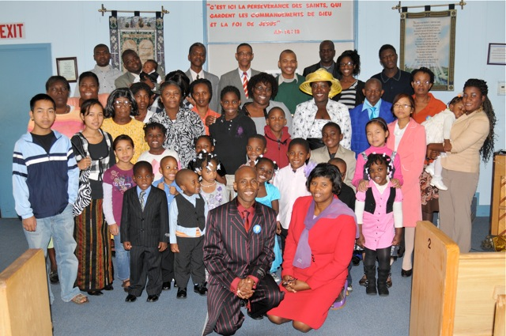
THE FRUIT OF THE SPIRIT IS:(LOVE)
John 14:15
¹⁵ If ye love me, keep my commandments.
FRENCH
Si vous m'aimez, gardez mes commandements.

Slide 14

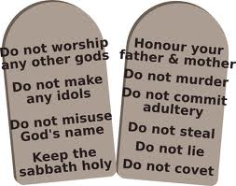
GOD’S TEN COMMANDMENTS OF LOVE
THE TEN COMMANDMENTS

Slide 15
The Fruit of the Spirit is Love
Ellen G. White was given a vision that demonstrates the importance of understanding how God defines the concept of love:
“Those who rose up with Jesus would send up their faith to Him in the holiest [the Most Holy Apartment], and pray, ‘My Father, give us Thy Spirit.” Then Jesus would breathe upon them the Holy Ghost. In that breath was light, power, and much love, joy, and peace.
“I turned to look at the company who were still bowed before the throne [who had not followed Christ by faith into the Most Holy Apartment]; they did not know that Jesus had left it. Satan appeared to be by the throne, trying to carry on the work of God. I saw them look up to the throne, and pray, ‘Father, give us Thy Spirit.’ Satan would then breathe upon them an unholy influence; in it there was light and much power, but no sweet love, joy, and peace.” [1]
Note the differences, Satan could not counterfeit “love, joy, and peace.” No one really knew what love was until the cross. The life and death of Jesus invested an obscure Greek word, agape, and its human response, faith, with enhanced meaning that turned the ancient “world upside down.”
“That the trial of your faith, being much more precious than of gold that perisheth, though it be tried with fire, might be found unto praise and honour and glory at the appearing of Jesus Christ” (1 Peter 1:7).
“The gold tried in the fire is faith that works by love. Only this can bring us into harmony with God. We may be active, we may do much work; but without love, such love as dwelt in the heart of Christ, we can never be numbered with the family of heaven.” [2]
Christ Himself makes clear what New Testament faith is, and his view is different from that of the popular concept. “For God so loved the world that He gave His only begotten Son, that whosoever believeth in Him …” Note: God’s love comes first, and until that love is revealed, there can be no believing. As the result of His “loving” and “giving,” the sinner finds it possible to “believe.” Thus, faith is a heart-experience, “heart-work” to borrow Ellen White’s phrase, and it cannot exist until God’s love is understood and appreciated. Please note very carefully a fundamental point: the “believing” is not motivated by a fear of perishing or an acquisitive reward of everlasting life. The believing is the direct result of the loving.
Early writing pg. 55,56

Slide 16
NOTE!
IF YOU LOVE GOD, EVEN THE SABBATH DAY YOU WILL KEEP IT HOLY BECAUSE IT IS ONE OF THE TEN. IN OTHER WORDS; DON’T TELL ME THAT YOU LOVE ME, BUT SHOW ME INSTEAD.
DO YOU KNOW THAT YOUR FAVORITE FRUIT HAS SEEDS? THEN BE YOUR FAVORITE FRUIT MAKE SOME SEEDS.

Slide 17
WHAT IS LOVE ACCORDING TO THE BIBLE?
1 Corinthians 13
1. If I speak in the tongues of men or of angels, but do not have love, I am only a resounding gong or a clanging cymbal. ² If I have the gift of prophecy and can fathom all mysteries and all knowledge, and if I have a faith that can move mountains, but do not have love, I am nothing.
FRENCH
1 Corinthiens 13
1. Quand je parlerais les langues des hommes et des anges, si je n'ai pas la charité, je suis un airain qui résonne, ou une cymbale qui retentit.
² Et quand j'aurais le don de prophétie, la science de tous les mystères et toute la connaissance, quand j'aurais même toute la foi jusqu'à transporter des montagnes, si je n'ai pas la charité, je ne suis rien.

Slide 18
WHAT IS LOVE ACCORDING TO THE BIBLE?
³ If I give all I possess to the poor and give over my body to hardship that I may boast, but do not have love, I gain nothing.
4 Love is patient, love is kind. It does not envy, it does not boast, it is not proud.
FRENCH
³ Et quand je distribuerais tous mes biens pour la nourriture des pauvres, quand je livrerais même mon corps pour être brûlé, si je n'ai pas la charité, cela ne me sert de rien.
4 La charité est patiente, elle est pleine de bonté; la charité n'est point envieuse; la charité ne se vante point, elle ne s'enfle point d'orgueil,

Slide 19
WHAT IS LOVE ACCORDING TO THE BIBLE?
⁵ It does not dishonor others, it is not self-seeking, it is not easily angered, it keeps no record of wrongs. ⁶ Love does not delight in evil but rejoices with the truth. ⁷ It always protects, always trusts, always hopes, always perseveres.
⁵ elle ne fait rien de malhonnête, elle ne cherche point son intérêt, elle ne s'irrite point, elle ne soupçonne point le mal, ⁶ elle ne se réjouit point de l'injustice, mais elle se réjouit de la vérité;
⁷ elle excuse tout, elle croit tout, elle espère tout, elle supporte tout.

Slide 20
WHAT IS LOVE ACCORDING TO THE BIBLE?
⁸ Love never fails. But where there are prophecies, they will cease; where there are tongues, they will be stilled; where there is knowledge, it will pass away.
9 For we know in part and we prophesy in part,
⁸ La charité ne périt jamais. Les prophéties prendront fin, les langues cesseront, la connaissance disparaîtra.
9 Car nous connaissons en partie, et nous prophétisons en partie,

Slide 21
WHAT IS LOVE ACCORDING TO THE BIBLE?
¹⁰ but when completeness comes, what is in part disappears. ¹¹ When I was a child, I talked like a child, I thought like a child, I reasoned like a child. When I became a man, I put the ways of childhood behind me.
¹⁰ mais quand ce qui est parfait sera venu, ce qui est partiel disparaîtra.
¹¹ Lorsque j'étais enfant, je parlais comme un enfant, je pensais comme un enfant, je raisonnais comme un enfant; lorsque je suis devenu homme, j'ai fait disparaître ce qui était de l'enfant.

Slide 22
WHAT IS LOVE ACCORDING TO THE BIBLE?
¹² For now we see only a reflection as in a mirror; then we shall see face to face. Now I know in part; then I shall know fully, even as I am fully known.
¹³ And now these three remain: faith, hope and love. But the greatest of these is love.
¹² Aujourd'hui nous voyons au moyen d'un miroir, d'une manière obscure, mais alors nous verrons face à face; aujourd'hui je connais en partie, mais alors je connaîtrai comme j'ai été connu.
¹³ Maintenant donc ces trois choses demeurent: la foi, l'espérance, la charité; mais la plus grande de ces choses, c'est la charité.

Slide 23
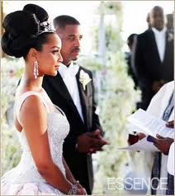
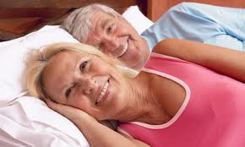
TRUE LOVE AND FALSE LOVE!
TRUE LOVE SAYS:
LET’S GET MARRIED FIRST.
FALSE LOVE SAYS:
LET’S HAVE A ONE NIGHT STAND FIRST TO SEE IF YOU ARE GOOD IN BED, KNOWING THAT THE devil is trying to set you up for helL .

Slide 24
LOVE
Matthew 19:7-10
⁷ “Why then,” they asked, “did Moses command that a man give his wife a certificate of divorce and send her away?”
⁸ Jesus replied, “Moses permitted you to divorce your wives because your hearts were hard. But it was not this way from the beginning. ⁹ I tell you that anyone who divorces his wife, except for sexual immorality, and marries another woman commits adultery.”
¹⁰ Jesus’ disciples then said to him, “If this is the case, it is better not to marry!”
FRENCH
⁷ Pourquoi donc, lui dirent-ils, Moïse a-t-il prescrit de donner à la femme une lettre de divorce et de la répudier?
⁸ Il leur répondit: C'est à cause de la dureté de votre coeur que Moïse vous a permis de répudier vos femmes; au commencement, il n'en était pas ainsi.
⁹ Mais je vous dis que celui qui répudie sa femme, sauf pour infidélité, et qui en épouse une autre, commet un adultère.
¹⁰ Ses disciples lui dirent: Si telle est la condition de l'homme à l'égard de la femme, il n'est pas avantageux de se marier.

Slide 25
LOVE
Matthew 5:43 You have heard that it was said, ‘Love your neighbor and hate your enemy. ⁴⁴ But I tell you, love your enemies and pray for those who persecute you,
Matthieu 5:43 Vous avez appris qu'il a été dit: Tu aimeras ton prochain, et tu haïras ton ennemi ⁴⁴ Mais moi, je vous dis: Aimez vos ennemis, bénissez ceux qui vous maudissent, faites du bien à ceux qui vous haïssent, et priez pour ceux qui vous maltraitent et qui vous persécutent,

Slide 26
LOVE
Matthew 22:37
³⁷ Jesus replied: “‘Love the Lord your God with all your heart and with all your soul and with all your mind.
Matthew 24:12
¹² Because of the increase of wickedness, the love of most will grow cold,
Matthieu 22:37
³⁷ Jésus lui répondit: Tu aimeras le Seigneur, ton Dieu, de tout ton coeur, de toute ton âme, et de toute ta pensée.
Matthieu 24:12
¹² Et, parce que l'iniquité se sera accrue, la charité du plus grand nombre se refroidira

Slide 27
LOVE
John 14:23, 24
²³ Jesus replied, “Anyone who loves me will obey my teaching. My Father will love them, and we will come to them and make our home with them. ²⁴ Anyone who does not love me will not obey my teaching. These words you hear are not my own; they belong to the Father who sent me.
Jean 14:23, 24
²³ Jésus lui répondit: Si quelqu'un m'aime, il gardera ma parole, et mon Père l'aimera; nous viendrons à lui, et nous ferons notre demeure chez lui. ²⁴ Celui qui ne m'aime pas ne garde point mes paroles. Et la parole que vous entendez n'est pas de moi, mais du Père qui m'a envoyé

Slide 28
LOVE
John 21:15-17
¹⁵ When they had finished eating, Jesus said to Simon Peter, “Simon son of John, do you love me more than these?” “Yes, Lord,” he said, “you know that I love you.” Jesus said, “Feed my lambs.”
Jean 21:15-17
¹⁵ Après qu'ils eurent mangé, Jésus dit à Simon Pierre: Simon, fils de Jonas, m'aimes-tu plus que ne m'aiment ceux-ci? Il lui répondit: Oui, Seigneur, tu sais que je t'aime. Jésus lui dit: Pais mes agneaux.

Slide 29
LOVE
¹⁶ Again Jesus said, “Simon son of John, do you love me?” He answered, “Yes, Lord, you know that I love you.” Jesus said, “Take care of my sheep.”
¹⁷ The third time he said to him, “Simon son of John, do you love me?” Peter was hurt because Jesus asked him the third time, “Do you love me?” He said, “Lord, you know all things; you know that I love you.” Jesus said, “Feed my sheep.
¹⁶ Il lui dit une seconde fois: Simon, fils de Jonas, m'aimes-tu? Pierre lui répondit: Oui, Seigneur, tu sais que je t'aime. Jésus lui dit: Pais mes brebis.
¹⁷ Il lui dit pour la troisième fois: Simon, fils de Jonas, m'aimes-tu? Pierre fut attristé de ce qu'il lui avait dit pour la troisième fois: M'aimes-tu? Et il lui répondit: Seigneur, tu sais toutes choses, tu sais que je t'aime. Jésus lui dit: Pais mes brebis

Slide 30
SHOW LOVE TO YOUR:
PARENTS, WIFE, HUSBAND
ENNEMIES, Neighbors
BROTHERS & SISTERS, CHILDREN UNCONDITIONALY
CHURCH, FAMILY, BIBLE,SELF AND MOST OF ALL LOVE YOUR GOD WITH ALL YOUR MIND, BODY AND SOUL. LOVE, LOVE,LOVE,LOVE,LOVE,LOVE, LOVE,LOVE,LOVE,LOVE. John 14:15 says “IF YOU LOVE ME KEEP MY COMMANDMENTS.” AMEN!

