Slide 1


THE FRUIT OF THE SPIRIT IS:
PEACE

Slide 2
WHAT IS THE DEFINITION OF PEACE?
Peace is:
1. the normal, non warring condition of a nation, group of nations, or the world.
2. ( often initial capital letter ) an agreement or treaty between warring or antagonistic nations, groups, etc., to end hostilities and abstain from further fighting or antagonism: the Peace of Ryswick.
3. a state of mutual harmony between people or groups, especially in personal relations: Try to live in peace with your neighbors.
4. the normal freedom from civil commotion and violence of a community; public order and security: He was arrested for being drunk and disturbing the peace.
5. cessation of or freedom from any strife or dissension.

Slide 3

THE FRUIT OF THE SPIRIT IS: PEACE
How important is peace in our life?
Peace is the essence of our existence. It is the freedom to pursue our dream. It is our ability to express ourselves. It is the opportunity to relate with others with understanding, good will and cooperation. It is a cornerstone of our survival and triumph as a species

Slide 4

PEACE ON EARTH

Slide 5
WHAT IS THE DEFINITION OF PEACE ACCORDING TO THE BIBLE?
PEACE IS THE THIRD FRUIT OF THE SPIRIT!
Identification
Peace is one of the fruits of the Holy Spirit. The Bible defines the fruit of the Holy Spirit in Galatians 5:22-23, and peace is the third characteristic mentioned. As we transform ourselves to reflect more of God's character, evidence of our relationship with God grows in our lives. Peace is one of the "fruits" or results of being in a relationship with God.
The Bible tells us that peace is a fruit of righteousness and that the effect of righteousness is "quietness and confidence forever" (Isaiah 32:17). Righteous is another way of being in harmony with God. So, being in harmony with God and loving God's law brings about great peace (Psalm 119:165). Peace is also a result of wisdom, which is also defined as following God's laws (Proverbs 3). According to Proverbs 3:17, wisdom's "ways are pleasant ways, and all her paths are peace."

Slide 6
THE FRUIT OF THE SPIRIT IS: (PEACE)
PEACE BE STILL!

Slide 7
THE FRUIT OF THE SPIRIT IS:
(PEACE)
Matthew 5:9
Blessed are the peacemakers, for they will be called children of God.
Matthew 11:28-30
“Come to me, all you who are weary and burdened, and I will give you rest. ²⁹ Take my yoke upon you and learn from me, for I am gentle and humble in heart, and you will find rest for your souls. ³⁰ For my yoke is easy and my burden is light.”
Matthieu 5:9
Heureux ceux qui procurent la paix, car ils seront appelés fils de Dieu
Matthieu 11:28-30
²⁸ Venez à moi, vous tous qui êtes fatigués et chargés, et je vous donnerai du repos.
²⁹ Prenez mon joug sur vous et recevez mes instructions, car je suis doux et humble de coeur; et vous trouverez du repos pour vos âmes.³⁰ Car mon joug est doux, et mon fardeau léger

Slide 8
THE FRUIT OF THE SPIRIT IS:
(PEACE)
Mark 9:50
“Salt is good, but if it loses its saltiness, how can you make it salty again? Have salt among yourselves, and be at peace with each other.”
John 14:27
Peace I leave with you; my peace I give you. I do not give to you as the world gives. Do not let your hearts be troubled and do not be afraid
Marc 9:50
Le sel est une bonne chose; mais si le sel devient sans saveur, avec quoi l'assaisonnerez-vous? Ayez du sel en vous-mêmes, et soyez en paix les uns avec les autres
Jean 14:27
Je vous laisse la paix, je vous donne ma paix. Je ne vous donne pas comme le monde donne. Que votre coeur ne se trouble point, et ne s'alarme point

Slide 9
THE FRUIT OF THE SPIRIT IS:
(PEACE)
John 16:33
“I have told you these things, so that in me you may have peace. In this world you will have trouble. But take heart! I have overcome the world.”
John 20:19
Jesus Appears to His Disciples
On the evening of that first day of the week, when the disciples were together, with the doors locked for fear of the Jewish leaders, Jesus came and stood among them and said, “Peace be with you!”
Jean 16:33
Je vous ai dit ces choses, afin que vous ayez la paix en moi. Vous aurez des tribulations dans le monde; mais prenez courage, j'ai vaincu le monde.
Jean 20:19
Le soir de ce jour, qui était le premier de la semaine, les portes du lieu où se trouvaient les disciples étant fermées, à cause de la crainte qu'ils avaient des Juifs, Jésus vint, se présenta au milieu d'eux, et leur dit: La paix soit avec vous!

Slide 10
THE FRUIT OF THE SPIRIT IS:
(PEACE)
Philippians 4:6
Do not be anxious about anything, but in every situation, by prayer and petition, with thanksgiving, present your requests to God.
Philippians 4:7
And the peace of God, which transcends all understanding, will guard your hearts and your minds in Christ Jesus.
Philippiens 4:6
Ne vous inquiétez de rien; mais en toute chose faites connaître vos besoins à Dieu par des prières et des supplications, avec des actions de grâces.
Philippiens 4:7
Et la paix de Dieu, qui surpasse toute intelligence, gardera vos coeurs et vos pensées en Jésus

Slide 11
THE FRUIT OF THE SPIRIT IS:
(PEACE)
Romans 5:1
Peace and Hope
Therefore, since we have been justified through faith, we have peace with God through our Lord Jesus Christ
Romans 12:17
¹⁷ Do not repay anyone evil for evil. Be careful to do what is right in the eyes of everyone
Romains 5:1
Étant donc justifiés par la foi, nous avons la paix avec Dieu par notre Seigneur Jésus Christ,
Romains 12:17
Ne rendez à personne le mal pour le mal. Recherchez ce qui est bien devant tous les hommes

Slide 12
THE FRUIT OF THE SPIRIT IS:
(PEACE)
Romans 14:17-19
¹⁷ For the kingdom of God is not a matter of eating and drinking, but of righteousness, peace and joy in the Holy Spirit, ¹⁸ because anyone who serves Christ in this way is pleasing to God and receives human approval. ¹⁹ Let us therefore make every effort to do what leads to peace and to mutual edification.
Romains 14:17-19
¹⁷ Car le royaume de Dieu, ce n'est pas le manger et le boire, mais la justice, la paix et la joie, par le Saint Esprit.
¹⁸ Celui qui sert Christ de cette manière est agréable à Dieu et approuvé des hommes.
¹⁹ Ainsi donc, recherchons ce qui contribue à la paix et à l'édification mutuelle.

Slide 13
THE FRUIT OF THE SPIRIT IS:
(PEACE)
1 Corinthians 7:15
¹⁵ But if the unbeliever leaves, let it be so. The brother or the sister is not bound in such circumstances; God has called us to live in peace.
2 Corinthians 13:11
Final Greetings
Finally, brothers and sisters, rejoice! Strive for full restoration, encourage one another, be of one mind, live in peace. And the God of love and peace will be with you.
1 Corinthiens 7:15
Si le non-croyant se sépare, qu'il se sépare; le frère ou la soeur ne sont pas liés dans ces cas-là. Dieu nous a appelés à vivre en paix
2 Corinthiens 13:11
Au reste, frères, soyez dans la joie, perfectionnez-vous, consolez-vous, ayez un même sentiment, vivez en paix; et le Dieu d'amour et de paix sera avec vous.

Slide 14
THE FRUIT OF THE SPIRIT IS:
(PEACE)
Isaiah 9:6
For to us a child is born, to us a son is given, and the government will be on his shoulders. And he will be called Wonderful Counselor, Mighty God, Everlasting Father, Prince of Peace.
Ésaïe 9:6
Car un enfant nous est né, un fils nous est donné, Et la domination reposera sur son épaule; On l'appellera Admirable, Conseiller, Dieu puissant, Père éternel, Prince de la paix.

Slide 15
THE FRUIT OF THE SPIRIT IS:
(PEACE)
Hebrews 12:14
Warning and Encouragement
14Make every effort to live in peace with everyone and to be holy; without holiness no one will see the Lord.
Hébreux 12:14
¹⁴ Recherchez la paix avec tous, et la sanctification, sans laquelle personne ne verra le Seigneur.

Slide 16
THE FRUIT OF THE SPIRIT IS:
(PEACE)
Mark 4:35-39
Jesus Calms the Storm
³⁵ That day when evening came, he said to his disciples, “Let us go over to the other side.” ³⁶ Leaving the crowd behind, they took him along, just as he was, in the boat. There were also other boats with him. ³⁷ A furious squall came up, and the waves broke over the boat, so that it was nearly swamped.
Marc 4:35-39
³⁵ Ce même jour, sur le soir, Jésus leur dit: Passons à l'autre bord.
³⁶ Après avoir renvoyé la foule, ils l'emmenèrent dans la barque où il se trouvait; il y avait aussi d'autres barques avec lui.
³⁷ Il s'éleva un grand tourbillon, et les flots se jetaient dans la barque, au point qu'elle se remplissait déjà.

Slide 17
THE FRUIT OF THE SPIRIT IS:
(PEACE)
³⁸ Jesus was in the stern, sleeping on a cushion. The disciples woke him and said to him, “Teacher, don’t you care if we drown?”
³⁹ He got up, rebuked the wind and said to the waves, “Quiet! Be still!” Then the wind died down and it was completely calm.
³⁸ Et lui, il dormait à la poupe sur le coussin. Ils le réveillèrent, et lui dirent: Maître, ne t'inquiètes-tu pas de ce que nous périssons?
³⁹ S'étant réveillé, il menaça le vent, et dit à la mer: Silence! tais-toi! Et le vent cessa, et il y eut un grand calme.

Slide 18

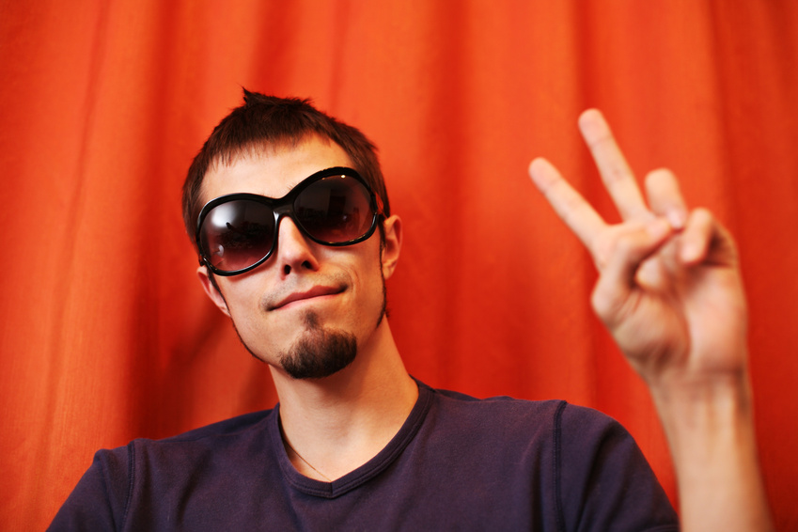
THE FRUIT OF THE SPIRIT IS:
(PEACE)
LET SING THIS SONGS TOGETHER.
I KNOW THE MASTER OF THE WIND.
CHANT
(#375 H. L. ) MAITRE ENTENT TU LA TEMPETE

