Slide 1
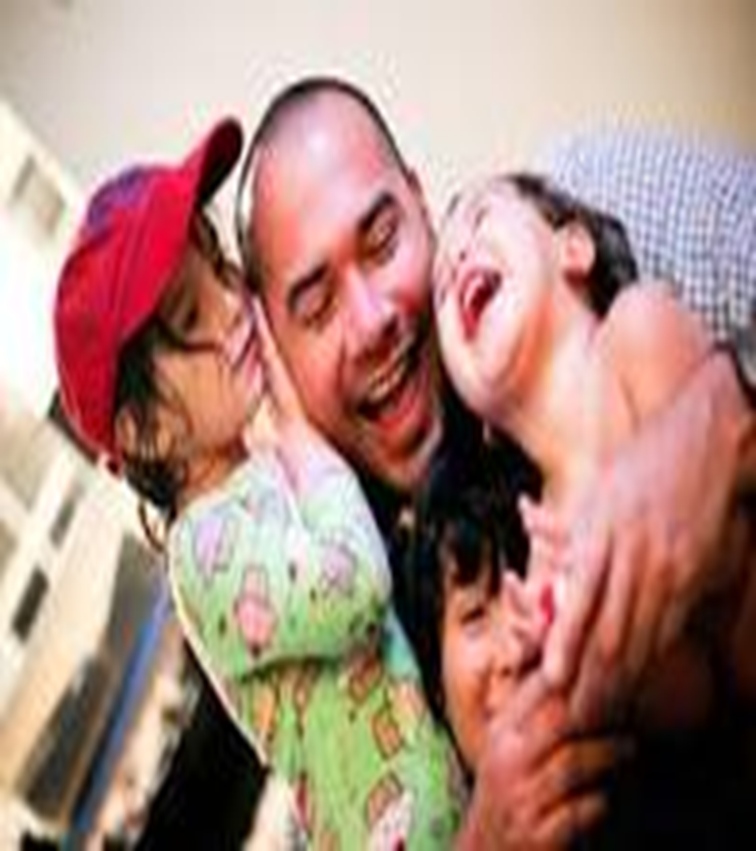
THE FRUIT OF THE SPIRIT IS: GOODNESS (LA BENIGNITE) OH MY GOODNESS!
Galatians 5:22,23
²² But the fruit of the Spirit is love, joy, peace, longsuffering, gentleness, goodness, faith, ²³ Meekness, temperance: against such there is no law.

Slide 2
GOODNESS (LA BENIGNITE)
THE FRUIT OF THE SPIRIT IS: GOODNESS OR Agathosune
The Hebrew and Greek uses are similar but the Hebrew, like the English, has a broader application. The Greek word, agathosune, at first glance seems very similar to chrestotes ("kindness"). However, closer examination of its use in the Scriptures reveals a word indicating zealous activity in doing good. Kindness or gentleness (chrestotes) is more passive.

Slide 3
WHAT IS GOODNESS?
Fruit of the Spirit is Goodness.
Agathosune is therefore active—even aggressive—goodness. The English word "goodness" includes many pleasing qualities whereas the Greek word indicates one particular quality. It is more than an excellence of character; it is character energized, expressing itself in active good. Agathosune is goodness, but it does not spare sharpness and rebuke to produce good in others. Thus God can correct, sometimes very severely, and it is goodness in action. Thus parents can correct their child, and it is good because it helps produce a responsible adult.

Slide 4
POSITIVITY OF GOODNESS
Galatians 5:22-23
Goodness (Amos 5:15; Prov. 25:22; Matthew 7:12; 19:16; Luke 6:27, 35; Rom. 12:17; II Cor. 5:20; Eph. 5:8-9; I Pet. 3:11; II Pet. 1:3-8) is the engagement of love! It displays integrity, honesty and compassion to others and allows us to do the right thing. Goodness takes our virtue and excellence and models it to others in the action of love. It is doing the right thing even when it does not feel like we should, as Joseph was betrayed and sold as a slave, he chose to make his situation good and help and treat others better than he needed too. Goodness is the model for people to repent and accept Christ

Slide 5
NEGATIVITY OF GOODNESS
Badness, cruelty, ruthlessness, depravity, debauchery and evil are the opposites. It is being mercilessness and unscrupulousness in our dealings toward others! When we fight against each other especially in the church, you have to see it as how hurtful and even pathetic it is in God's eyes!
· Here are positive examples from Scripture
(Gen. 39; Luke 10:30-37; Acts 7:60; 9:36; Luke 23:34; Gal. 6:10; II Thess. 1:11)
· Here is are negative examples from Scripture (Gen. 4:8; Duet. 25:17-19; Joshua 7; Luke 9:54

Slide 6
GOODNESS (LA BENIGNITE)
Proverbs 25:21
If your enemy is hungry, give him food to eat; if he is thirsty, give him water to drink
Proverbes 25:21
Si ton ennemi a faim, donne-lui du pain à manger; S'il a soif, donne-lui de l'eau à boire

Slide 7
GOODNESS (LA BENIGNITE)
Matthew 7:12
So in everything, do to others what you would have them do to you, for this sums up the Law and the Prophets.
Matthieu 7:12
Tout ce que vous voulez que les hommes fassent pour vous, faites-le de même pour eux, car c'est la loi et les prophètes.

Slide 8
GOODNESS (LA BENIGNITE)
Matthew 19:16
The Rich and the Kingdom of God
¹⁶ Just then a man came up to Jesus and asked, “Teacher, what good thing must I do to get eternal life?”
Matthieu 19:16
¹⁶ Et voici, un homme s'approcha, et dit à Jésus: Maître, que dois-je faire de bon pour avoir la vie éternelle?

Slide 9
GOODNESS (LA BENIGNITE)
Luke 6:27, 35
Love for Enemies
²⁷ “But to you who are listening I say: Love your enemies, do good to those who hate you,
³⁵ But love your enemies, do good to them, and lend to them without expecting to get anything back. Then your reward will be great, and you will be children of the Most High, because he is kind to the ungrateful and wicked.
Luc 6:27, 35
Mais je vous dis, à vous qui m'écoutez: Aimez vos ennemis, faites du bien à ceux qui vous haïssent,
35 Mais aimez vos ennemis, faites du bien, et prêtez sans rien espérer. Et votre récompense sera grande, et vous serez fils du Très Haut, car il est bon pour les ingrats et pour les méchants.

Slide 10
GOODNESS (LA BENIGNITE)
2 Peter 1:5
For this very reason, make every effort to add to your faith goodness; and to goodness, knowledge;
2 Pierre 1:5
à cause de cela même, faites tous vos efforts pour joindre à votre foi la vertu, à la vertu la science

Slide 11
GOODNESS (LA BENIGNITE)
Exodus 33:19
And the Lord said, “I will cause all my goodness to pass in front of you, and I will proclaim my name, the Lord, in your presence. I will have mercy on whom I will have mercy, and I will have compassion on whom I will have compassion.
Exode 33:19
L'Éternel répondit: Je ferai passer devant toi toute ma bonté, et je proclamerai devant toi le nom de l'Éternel; je fais grâce à qui je fais grâce, et miséricorde à qui je fais miséricorde.

Slide 12
GOODNESS (LA BENIGNITE)
Psalm 23:6
Surely your goodness and love will follow me all the days of my life, and I will dwell in the house of the Lord forever
Psaumes 23:6
Oui, le bonheur et la grâce m'accompagneront Tous les jours de ma vie, Et j'habiterai dans la maison de l'Éternel Jusqu'à la fin de mes jours.

Slide 13
GOODNESS (LA BENIGNITE)
Psalm 27:13
I remain confident of this: I will see the goodness of the Lord in the land of the living.
Psaumes 27:13
Oh! si je n'étais pas sûr de voir la bonté de l'Éternel Sur la terre des vivants!...

Slide 14
GOODNESS (LA BENIGNITE)
Psalm 31:19
How abundant are the good things that you have stored up for those who fear you, that you bestow in the sight of all, on those who take refuge in you
Psaumes 31:19
Oh! combien est grande ta bonté, Que tu tiens en réserve pour ceux qui te craignent, Que tu témoignes à ceux qui cherchent en toi leur refuge, A la vue des fils de l'homme!

Slide 15
GOODNESS (LA BENIGNITE)
Romans 15:14
Paul the Minister to the Gentiles
14-I myself am convinced, my brothers and sisters, that you yourselves are full of goodness, filled with knowledge and competent to instruct one another.
Romains 15:14
Pour ce qui vous concerne, mes frères, je suis moi-même persuadé que vous êtes pleins de bonnes, dispositions, remplis de toute connaissance, et capables de vous exhorter les uns les autres.

Slide 16
GOODNESS (LA BENIGNITE)
FINALY!
Ephesians 5:9
(for the fruit of the light consists in all goodness, righteousness and truth)
Éphésiens 5:9
Car le fruit de la lumière consiste en toute sorte de bonté, de justice et de vérité.

Slide 17
GOODNESS (LA BENIGNITE)
OH MY GOODNESS! FINALY

