Slide 1
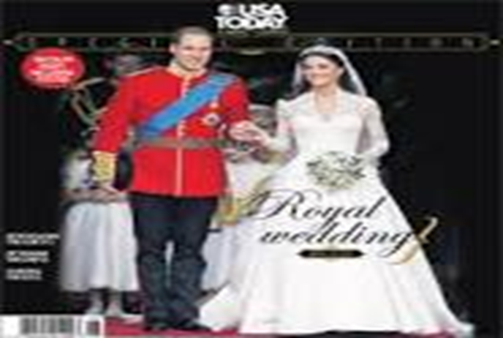
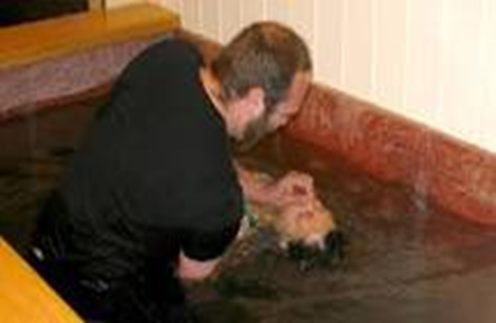
THE FRUIT OF THE SPIRIT IS:
FAITH OR
FAITHFULNESS
FRENCH
LA FOI OU LA FIDELITE

Slide 2
THE FRUIT OF THE SPIRIT IS: FAITH OR LA FOI
World English Dictionary. DEFINITION
FAITH
1. strong or unshakeable belief in something, esp without proof or evidence
2. a specific system of religious beliefs: the Jewish faith
3. Christianity trust in God and in his actions and promises
4. a conviction of the truth of certain doctrines of religion, esp when this is not based on reason
5. complete confidence or trust in a person, remedy, etc
6. any set of firmly held principles or beliefs
7. allegiance or loyalty, as to a person or cause (esp in the phrases keep faith , break faith )
8. bad faith insincerity or dishonesty
9. good faith honesty or sincerity, as of intention in business (esp in the phrase in good faith ) interj
10. archaic indeed; really (also in the phrases by my faith , in faith )
[C12: from Anglo-French feid , from Latin fidēs trust, confidence]

Slide 3
THE FRUIT OF THE SPIRIT IS: FAITH OR LA FOI
Encyclopedia
faith
inner attitude, conviction, or trust relating man to a supreme God or ultimate salvation. In religious traditions stressing divine grace, it is the inner certainty or attitude of love granted by God himself. In Christian theology, faith is the divinely inspired human response to God's historical revelation through Jesus Christ and, consequently, is of crucial significance.

Slide 4
THE FRUIT OF THE SPIRIT IS: FAITH OR LA FOI
WHAT IS FAITH OR (LA FOI) ?
PLEASE GIVE YOUR PERSONAL EXPERIENCE WITH FAITH IN ACTION!

Slide 5
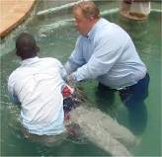
THE FRUIT OF THE SPIRIT IS: FAITH OR LA FOI

Slide 6
THE FRUIT OF THE SPIRIT IS: FAITH OR LA FOI
WHAT IS FAITH OR (LA FOI) ACCORDING TO THE BIBLE?
HEBREWS 11
1 Now faith is confidence in what we hope for and assurance about what we do not see
3 By faith we understand that the universe was formed at God’s command, so that what is seen was not made out of what was visible.
4 By faith Abel brought God a better offering than Cain did. By faith he was commended as righteous, when God spoke well of his offerings. And by faith Abel still speaks, even though he is dead.
FRENCH
1 Or la foi est une ferme assurance des choses qu'on espère, une démonstration de celles qu'on ne voit pas.
2 Pour l'avoir possédée, les anciens ont obtenu un témoignage favorable.
3 C'est par la foi que nous reconnaissons que le monde a été formé par la parole de Dieu, en sorte que ce qu'on voit n'a pas été fait de choses visibles.
4 C'est par la foi qu'Abel offrit à Dieu un sacrifice plus excellent que celui de Caïn; c'est par elle qu'il fut déclaré juste, Dieu approuvant ses offrandes; et c'est par elle qu'il parle encore, quoique mort.

Slide 7
THE FRUIT OF THE SPIRIT IS: FAITH OR LA FOI
5 By faith Enoch was taken from this life, so that he did not experience death: “He could not be found, because God had taken him away.” For before he was taken, he was commended as one who pleased God.
6 And without faith it is impossible to please God, because anyone who comes to him must believe that he exists and that he rewards those who earnestly seek him.
5 C'est par la foi qu'Énoch fut enlevé pour qu'il ne vît point la mort, et qu'il ne parut plus parce Dieu l'avait enlevé; car, avant son enlèvement, il avait reçu le témoignage qu'il était agréable à Dieu.
6 Or sans la foi il est impossible de lui être agréable; car il faut que celui qui s'approche de Dieu croie que Dieu existe, et qu'il est le rémunérateur de ceux qui le cherchent.

Slide 8
THE FRUIT OF THE SPIRIT IS: FAITH OR LA FOI
30 By faith the walls of Jericho fell, after the army had marched around them for seven days.
30 C'est par la foi que les murailles de Jéricho tombèrent, après qu'on en eut fait le tour pendant sept jours.

Slide 9
THE FRUIT OF THE SPIRIT IS: FAITH OR LA FOI
James 2:14
Faith and Deeds
14 What good is it, my brothers and sisters, if someone claims to have faith but has no deeds? Can such faith save them?
Jacques 2:14
Mes frère, que sert-il à quelqu'un de dire qu'il a la foi, s'il n'a pas les oeuvres? La foi peut-elle le sauver?

Slide 10
THE FRUIT OF THE SPIRIT IS: FAITH OR LA FOI
Proverbs 28:20
20 A faithful person will be richly blessed, but one eager to get rich will not go unpunished.
Proverbes 28:20
20 Un homme fidèle est comblé de bénédictions, Mais celui qui a hâte de s'enrichir ne reste pas impuni.

Slide 11
THE FRUIT OF THE SPIRIT IS: FAITH OR LA FOI
Matthew 13:58
And he did not do many miracles there because of their lack of faith.
Matthieu 13:58
Et il ne fit pas beaucoup de miracles dans ce lieu, à cause de leur incrédulité.

Slide 12
THE FRUIT OF THE SPIRIT IS: FAITH OR LA FOI
1 Timothy 4:1
The Spirit clearly says that in later times some will abandon the faith and follow deceiving spirits and things taught by demons.
1 Timothée 4:1
Mais l'Esprit dit expressément que, dans les derniers temps, quelques-uns abandonneront la foi, pour s'attacher à des esprits séducteurs et à des doctrines de démons,

Slide 13
THE FRUIT OF THE SPIRIT IS: FAITH OR LA FOI
Acts 14:22
22 strengthening the disciples and encouraging them to remain true to the faith. “We must go through many hardships to enter the kingdom of God,” they said.
Actes 14:22
22 fortifiant l'esprit des disciples, les exhortant à persévérer dans la foi, et disant que c'est par beaucoup de tribulations qu'il nous faut entrer dans le royaume de Dieu

Slide 14
THE FRUIT OF THE SPIRIT IS: FAITH OR LA FOI
Ephesians 2:8
For it is by grace you have been saved, through faith—and this is not from yourselves, it is the gift of God—
Éphésiens 2:8
Car c'est par la grâce que vous êtes sauvés, par le moyen de la foi. Et cela ne vient pas de vous, c'est le don de Dieu.

Slide 15
THE FRUIT OF THE SPIRIT IS: FAITH OR LA FOI
Romans 1:17
For in the gospel the righteousness of God is revealed—a righteousness that is by faith from first to last, just as it is written: “The righteous will live by faith.”
Romains 1:17
parce qu'en lui est révélée la justice de Dieu par la foi et pour la foi, selon qu'il est écrit: Le juste vivra par la foi.

Slide 16
THE FRUIT OF THE SPIRIT IS: FAITH OR LA FOI
Romans 10:17
Consequently, faith comes from hearing the message, and the message is heard through the word about Christ.
Romains 10:17
Ainsi la foi vient de ce qu'on entend, et ce qu'on entend vient de la parole de Christ.

Slide 17
THE FRUIT OF THE SPIRIT IS: FAITH OR LA FOI
Matthew 9:2
² Some men brought to him a paralyzed man, lying on a mat. When Jesus saw their faith, he said to the man, “Take heart, son; your sins are forgiven.”
Matthieu 9:2
2 Et voici, on lui amena un paralytique couché sur un lit. Jésus, voyant leur foi, dit au paralytique: Prends courage, mon enfant, tes péchés te sont pardonnés.

Slide 18
THE FRUIT OF THE SPIRIT IS: FAITH OR LA FOI
Matthew 9:20-22
20 Just then a woman who had been subject to bleeding for twelve years came up behind him and touched the edge of his cloak. 21 She said to herself, “If I only touch his cloak, I will be healed.”
22 Jesus turned and saw her. “Take heart, daughter,” he said, “your faith has healed you.” And the woman was healed at that moment.
Matthieu 9:20-22
20 Et voici, une femme atteinte d'une perte de sang depuis douze ans s'approcha par derrière, et toucha le bord de son vêtement.
21 Car elle disait en elle-même: Si je puis seulement toucher son vêtement, je serai guérie.
22 Jésus se retourna, et dit, en la voyant: Prends courage, ma fille, ta foi t'a guérie. Et cette femme fut guérie à l'heure même.

Slide 19
THE FRUIT OF THE SPIRIT IS: FAITH OR LA FOI
BE FAITHFUL TO DEATH!
Lamentations 3:23
They are new every morning;
great is your faithfulness.
FRENCH
23 Elles se renouvellent chaque matin. Oh! que ta fidélité est grande!

Slide 20
THE FRUIT OF THE SPIRIT IS: FAITHFULNESS OR LA FIDELITE
SING WITH ME
GREAT IS THY FAITHFULNESS
OH GOD MY FATHER…………………………………………………………………………………

