Slide 1
THE FRUIT OF THE SPIRIT IS:
MEEKNESS
FRENCH: LA DOUCEUR/
débonnaires

Slide 2
WHAT IS THE DEFINITION OF MEEKNESS IN THE DICTIONARY?
humbly patient or docile, as under provocation from others. 2. overly submissive or compliant; spiritless; tame. 3. Obsolete. gentle; kind.
The Hebrew word translated "meekness" is anav or anaw, meaning "depressed (figuratively), in mind (gentle) or circumstances (needy, especially saintly): humble, lowly, meek, poor" (Strong's Exhaustive Concordance). The translation depends upon the context in which it appears. The Gesenius Hebrew-Chaldee Lexicon adds, "afflicted, miserable . . . ; commonly with the added notion of a lowly, pious, and modest mind, which prefers to bear injuries rather than return them". The Theological Wordbook of the Old Testament indicates why this word is so difficult to express as a single term: "anaw expresses the intended outcome of affliction"

Slide 3
WHAT IS THE DEFINITION OF MEEKNESS IN THE DICTIONARY?
The Greek word, prautes, the one to which Barclay referred, is no easier. James Strong defines it only as "mildness; i.e., (by implication) humility". Vincent's Word Studies of the New Testament says that "Plato opposes it to fierceness or cruelty" (vol. 1, p. 37). In The Complete Word Study Dictionary New Testament, Spiros Zodhiates writes:
Prautes, according to Aristotle, is the middle standing between two extremes, getting angry without reason, and not getting angry at all. Therefore, prautes is getting angry at the right time, in the right measure, and for the right reason. . . . [I]t is a condition of mind and heart which demonstrates gentleness, not in weakness, but in power. It is a balance born in strength of character.

Slide 4
THE DEFINITION OF MEEKNESS !
What does meekness mean in the Bible?
The usual definition of meekness in the Bible is "strength under control.“ The "world" defines strong people as those who are assertive, take charge, proud, self-sufficient, self-reliant, and independent. A meek person is the opposite of these things, therefore, many people associate meekness with weakness. A meek person is willing to be submissive, is humble and gentle, relies on God and is dependent on Him to provide strength.

Slide 5
THE DEFINITION OF MEEKNESS
Three people in the Bible are specifically described as being meek: Jesus (Mt 11:29)(Mt 21:5), Paul (1 Cor 10:1), and Moses (Num 12:3). Each of these men was amongst the most persecuted men in the Bible. (See: Paul's Trials for more on the trials he faced) However, they displayed the "strength under control" through their persecutions that it takes to be meek. One of the definitions in Webster's Dictionary for meek is "enduring injury with patience and without resentment." Certainly each of these men qualifies for that distinction.

Slide 6
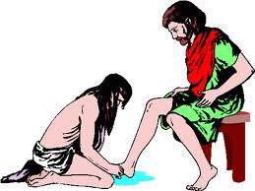
What does meekness/ Débonnaires mean in the Bible?
Matthew 11:29
Take my yoke upon you and learn from me, for I am gentle and humble in heart, and you will find rest for your souls.
FRENCH
Matthieu 11:29
Prenez mon joug sur vous et recevez mes instructions, car je suis doux et humble de coeur; et vous trouverez du repos pour vos âmes.
THE HUMBLENESS OF JESUS.

Slide 7
What does meekness/ Débonnaires mean in the Bible?
Matthew 21:5
“Say to Daughter Zion,‘See, your king comes to you, gentle and riding on a donkey, and on a colt, the foal of a donkey.’”
FRENCH
Matthieu 21:5
Dites à la fille de Sion: Voici, ton roi vient à toi, Plein de douceur, et monté sur un âne, Sur un ânon, le petit d'une ânesse

Slide 8
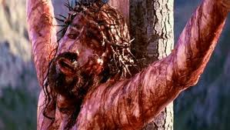
What does meekness/ Débonnaires mean in the Bible?
HUMBLENESS WILL MAKE YOU GET THE BEATING AND EVEN NAIL TO THE CROSS FOR SOMEONE WHO IS GUILTY
JUST TO SAVE THEIR LIFE.

Slide 9
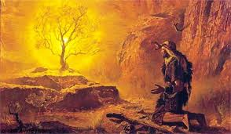
What does meekness/ Débonnaires mean in the Bible?
Numbers 12:3
(Now Moses was a very humble man, more humble than anyone else on the face of the earth.)
FRENCH
Nombres 12:3
Et l'Éternel l'entendit. Or, Moïse était un homme fort patient, plus qu'aucun homme sur la face de la terre

Slide 10
What does meekness/ Débonnaires mean in the Bible?
Zephaniah 2:3
Seek the Lord, all you humble of the land, you who do what he commands. Seek righteousness, seek humility; perhaps you will be sheltered on the day of the Lord’s anger.
FRENCH
Sophonie 2:3
Cherchez l'Éternel, vous tous, humbles du pays, Qui pratiquez ses ordonnances! Recherchez la justice, recherchez l'humilité! Peut-être serez-vous épargnés au jour de la colère de l'Éternel

Slide 11
What does meekness/ Débonnaires mean in the Bible?
Galatians 5:23
gentleness and self-control. Against such things there is no law.

Slide 12
What does meekness/ Débonnaires mean in the Bible?
Galatians 6:1
Doing Good to All
Brothers and sisters, if someone is caught in a sin, you who live by the Spirit should restore that person gently. But watch yourselves, or you also may be tempted.
FRENCH
Galates 6:1
Frères, si un homme vient à être surpris en quelque faute, vous qui êtes spirituels, redressez-le avec un esprit de douceur. Prends garde à toi-même, de peur que tu ne sois aussi tenté.

Slide 13
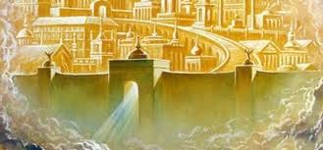
What does meekness/ Débonnaires mean in the Bible?
Matthew 5:5
Blessed are the meek, for they will inherit the earth
FRENCH
Matthieu 5:5
Heureux les débonnaires, car ils hériteront la terre!

Slide 14
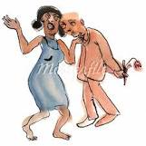
What does meekness/ Débonnaires mean in the Bible?
1 Corinthians 4:21
What do you prefer? Shall I come to you with a rod of discipline, or shall I come in love and with a gentle spirit?
FRENCH
1 Corinthiens 4:21
Que voulez-vous? Que j'aille chez vous avec une verge, ou avec amour et dans un esprit de douceur?

Slide 15
What does meekness/ Débonnaires mean in the Bible?
2 Corinthians 10:1
Paul’s Defense of His Ministry
By the humility and gentleness of Christ, I appeal to you—I, Paul, who am “timid” when face to face with you, but “bold” toward you when away!
FRENCH
2 Corinthiens 10:1
Moi Paul, je vous prie, par la douceur et la bonté de Christ, -moi, humble d'apparence quand je suis au milieu de vous, et plein de hardiesse à votre égard quand je suis éloigné,

Slide 16
What does meekness/ Débonnaires mean in the Bible?
Ephesians 4:1
Unity and Maturity in the Body of Christ
As a prisoner for the Lord, then, I urge you to live a life worthy of the calling you have received.
2 Be completely humble and gentle; be patient, bearing with one another in love.
FRENCH
1 Je vous exhorte donc, moi, le prisonnier dans le Seigneur, à marcher d'une manière digne de la vocation qui vous a été adressée
2 en toute humilité et douceur, avec patience, vous supportant les uns les autres avec charité

Slide 17
What does meekness/ Débonnaires mean in the Bible?
1 Timothy 6:11
Final Charge to Timothy
11 But you, man of God, flee from all this, and pursue righteousness, godliness, faith, love, endurance and gentleness.
FRENCH
1 Timothée 6:11
Pour toi, homme de Dieu, fuis ces choses, et recherche la justice, la piété, la foi, la charité, la patience, la douceur.

Slide 18
What does meekness/ Débonnaires mean in the Bible?
2 Timothy 2:25
Opponents must be gently instructed, in the hope that God will grant them repentance leading them to a knowledge of the truth,
FRENCH
2 Timothée 2:25
il doit redresser avec douceur les adversaires, dans l'espérance que Dieu leur donnera la repentance pour arriver à la connaissance de la vérité,

Slide 19
What does meekness/ Débonnaires mean in the Bible?
Titus 3:2
to slander no one, to be peaceable and considerate, and always to be gentle toward everyone.
FRENCH
Tite 3:2
de ne médire de personne, d'être pacifiques, modérés, pleins de douceur envers tous les hommes.

Slide 20
What does meekness/ Débonnaires mean in the Bible?
James 1:21
Therefore, get rid of all moral filth and the evil that is so prevalent and humbly accept the word planted in you, which can save you.
FRENCH
Jacques 1:21
C'est pourquoi, rejetant toute souillure et tout excès de malice, recevez avec douceur la parole qui a été planté en vous, et qui peut sauver vos âmes.

Slide 21
What does meekness/ Débonnaires mean in the Bible?
James 3:13
Two Kinds of Wisdom
13 Who is wise and understanding among you? Let them show it by their good life, by deeds done in the humility that comes from wisdom.
FRENCH
Jacques 3:13
Lequel d'entre vous est sage et intelligent? Qu'il montre ses oeuvres par une bonne conduite avec la douceur de la sagesse.

Slide 22
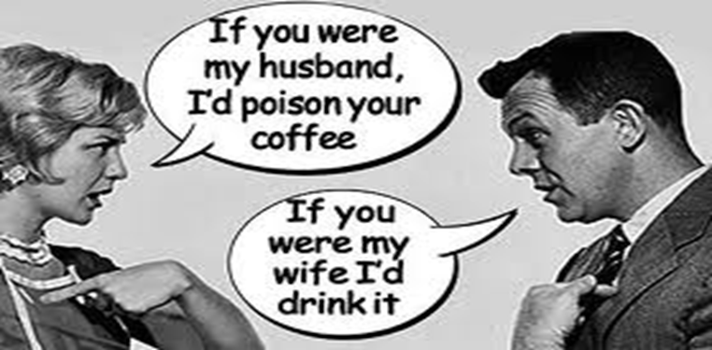
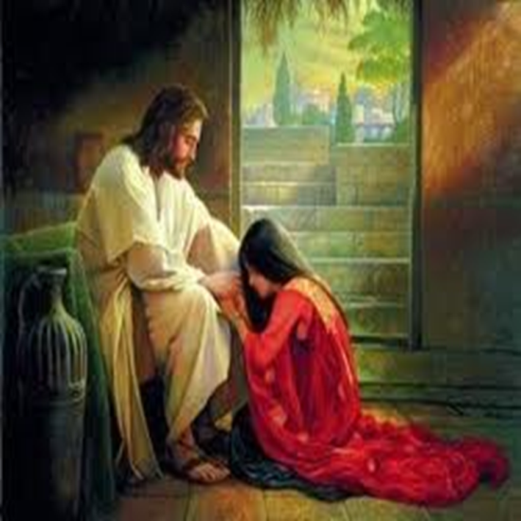
What does meekness/ Débonnaires mean in the Bible?
1 Peter 3:15
But in your hearts revere Christ as Lord. Always be prepared to give an answer to everyone who asks you to give the reason for the hope that you have. But do this with gentleness and respect,
FRENCH
1 Pierre 3:15
Mais sanctifiez dans vos coeurs Christ le Seigneur, étant toujours prêts à vous défendre, avec douceur et respect, devant quiconque vous demande raison de l'espérance qui est en vous.

